Slide 1
Visible Light Communication Modulation Toolkit using Open Source GNU Radio Framework
- Saaransh pandey, anand singh, vivek ashok bohara, anand srivastava

Slide 2
Aim
To develop a user-centric simulation platform for indoor visible light communication systems using open source GNU Radio software.
The VLC modulation kit provides the user an option to choose from the type of modulation schemes (OOK, DCO-OFDM or ACO-OFDM) along with other parameters (M-QAM order, etc.) to implement a VLC system.
Further, it provides bit error rate (BER) results to evaluate the performance of the selected modulation scheme.

Slide 3
Why GNU Radio
GNU Radio is a free & open-source software development toolkit that provides signal processing blocks to implement software radios.
GNU Radio is based on the Python interpreted language. This language makes it easy to create connections between processing blocks. By linked processing blocks with each other, you create a flow graph which allows you to design complex waveforms.
It can be used with readily-available low-cost external RF hardware to create software-defined radios, or without hardware in a simulation-like environment. GNU Radio has filters, channel codes, decoders, and many other elements (blocks) which are typically found in radio systems.
Notes:
It is widely used in hobbyist, academic and commercial environments to support both wireless communications research and real-world radio systems.

Slide 4
Implementation: Transmission Block
Blocks are executed in the following steps:
• The input (text message/audio file/video file) is read and converted into bits (array).
• These bits (array) are then encoded.
• Then these encoded bits are modulated (OOK, DCO-OFDM or ACO-OFDM) as per the user input and saved in a file which is to be used later during decoding of the transmitted bits.
• In real-time scenario, final File Sink Block will be replaced by the USRP Sink.

Slide 5
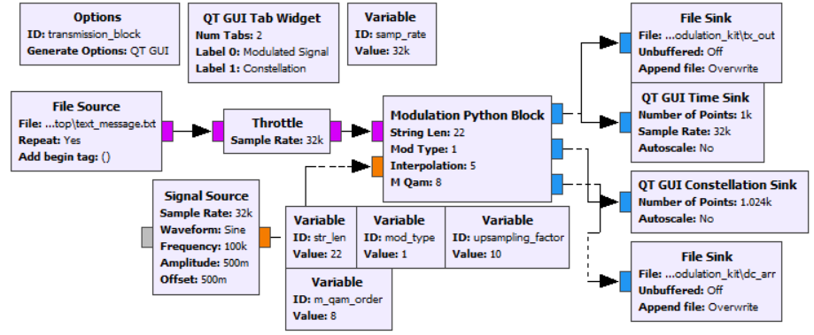
VLC Modulation Toolkit: Transmission Block
Flow graph of transmission block.

Slide 6
Implementation: Receiver Block
Blocks are executed in the following steps:
• The received (transmitted) signal from the transmission block is added to the Gaussian noise signal, generated with the help of Noise Source Block to simulate real-time scenario.
• Then this signal is passed through the Python Block where the signal is demodulated and decoded.
• Finally the bits (array) are converted back to the string.
• The console displays the received message along with the calculated BER of the signal.
• In real-time scenario, File Sink Block will be replaced by the USRP Source.

Slide 7
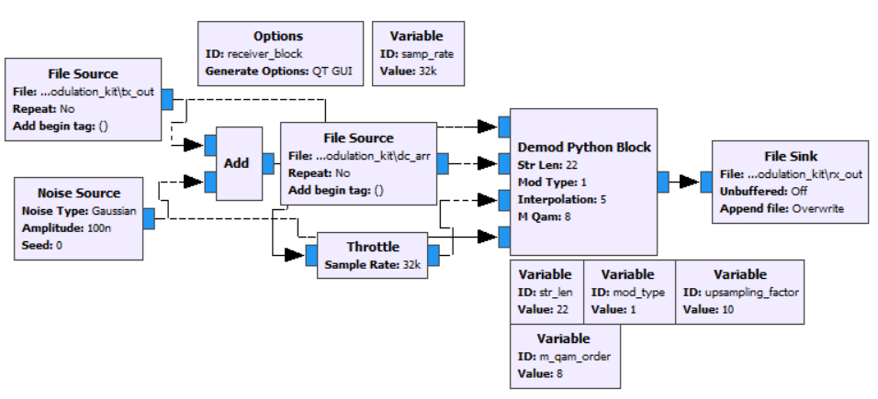
VLC Modulation Toolkit: Receiver Block
Flow graph of receiver block.

Slide 8
Results
System Model Parameter
III. Simulation Results for ACO-OFDM
Parameter | Value
Length of string | 3000
Total no. of bits | 24000
Up-sampling Factor | 10
Modulation scheme (OOK, DCO-OFDM or ACO-OFDM) | User-defined (0, 1 or 2)
M-QAM order | User-defined (4, 8 or 16)
Noise Type | Gaussian
Range of amplitude for OOK | [0,1]
S. No. | M-QAM Order | Noise Amplitude | BER
1. | 4-QAM | 0.01 | 0
2. |  | 0.03 | 9.50 x 10⁻³
3. |  | 0.05 | 5.72 x 10⁻²
4. |  | 0.1 | 1.56 x 10⁻¹
5. |  | 0.5 | 3.99 x 10⁻¹
6. | 8-QAM | 0.01 | 0
7. |  | 0.03 | 6.95 x 10⁻³
8. |  | 0.05 | 4.08 x 10⁻²
9. |  | 0.1 | 1.15 x 10⁻¹
10. |  | 0.5 | 3.88 x 10⁻¹
11. | 16-QAM | 0.01 | 0
12. |  | 0.03 | 7.20 x 10⁻³
13. |  | 0.05 | 4.17 x 10⁻²
14. |  | 0.1 | 1.10 x 10⁻¹
15. |  | 0.5 | 3.82 x 10⁻¹
II. Simulation Results for DCO-OFDM
S. No. | M-QAM Order | Noise Amplitude | BER
1. | 4-QAM | 0.03 | 0
2. |  | 0.05 | 1.66 x 10⁻⁴
3. |  | 0.1 | 3.82 x 10⁻²
4. |  | 0.5 | 3.58 x 10⁻¹
5. | 8-QAM | 0.03 | 0
6. |  | 0.05 | 1.66 x 10⁻⁴
7. |  | 0.1 | 3.10 x 10⁻²
8. |  | 0.5 | 3.43 x 10⁻¹
9. | 16-QAM | 0.03 | 0
10. |  | 0.05 | 2.08 x 10⁻⁴
11. |  | 0.1 | 2.97 x 10⁻²
12. |  | 0.5 | 3.39 x 10⁻¹
I. Simulation Results for OOK
S. No. | Modulation | Noise Amplitude | BER
1. | OOK | 0 | 0
2. |  | 10⁻⁷ | 7.08 x 10⁻⁴
3. |  | 10⁻⁵ | 2.52 x 10⁻²
4. |  | 10⁻³ | 1.61 x 10⁻¹
5. |  | 0.1 | 1.62 x 10⁻¹
*Noise Amplitude :The standard deviation of a 1-d noise process.
Notes:
Noise Amplitude :The standard deviation of a 1-d noise process. If this is the complex source, this parameter is split among the real and imaginary parts

Slide 9
Conclusion
From the simulated results obtained, the performance of the VLC Modulation Toolkit has been verified for different modulation schemes. This VLC Modulation Toolkit can be used in VLC systems in real-time conditions, along with the help of USRPs. In future, any other modulation scheme of choice could be added in the VLC modulation kit.

Slide 10
Thank You!

